Slide 1
IBM Data Science Capstone Project
Analyzing Boston Real Estate Market with respect to Crimes and rents

Slide 2

Boston City

Slide 3
Boston Real Estate
Factors
Crimes in Boston
Rents in Boston
Stakeholders
Boston Police Department
Real Estate Agent
Boston City Government
Entrepreneur

Slide 4
Data
Crimes in Boston
This dataset is taken from Kaggle which contains the data of all the crimes occurred in different neighborhoods in Boston in recent times
Boston Rental Data
Data is extracted from Zillow which is real estate website containing most up to date rental data in Boston Neighborhoods
Boston Police Districts
Data is sourced from Boston Police Department website. We need this because we need to encode District Abbreviations into Boston Neighborhoods

Slide 5
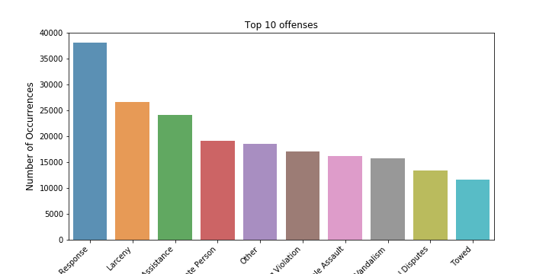
Top 10 offenses in Boston

Slide 6
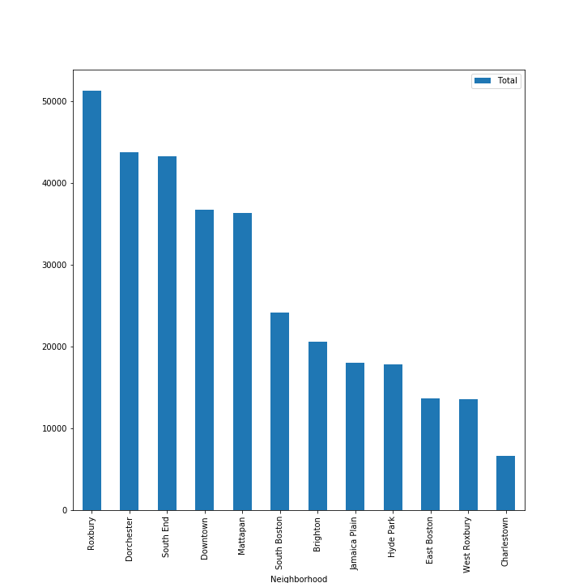
Crimes in each Neighborhood

Slide 7
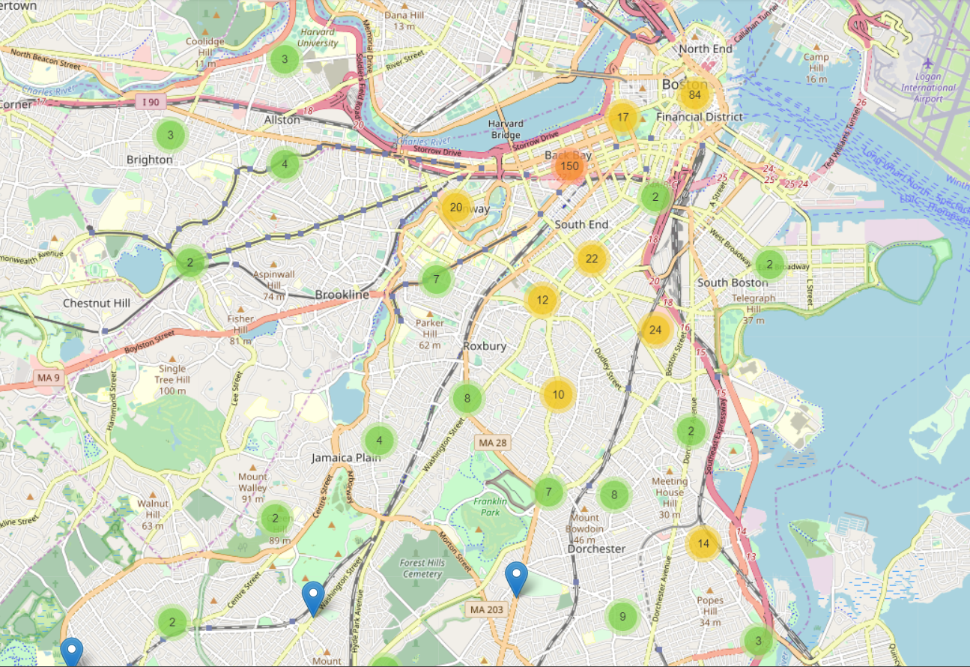
Clusters of Crimes

Slide 8
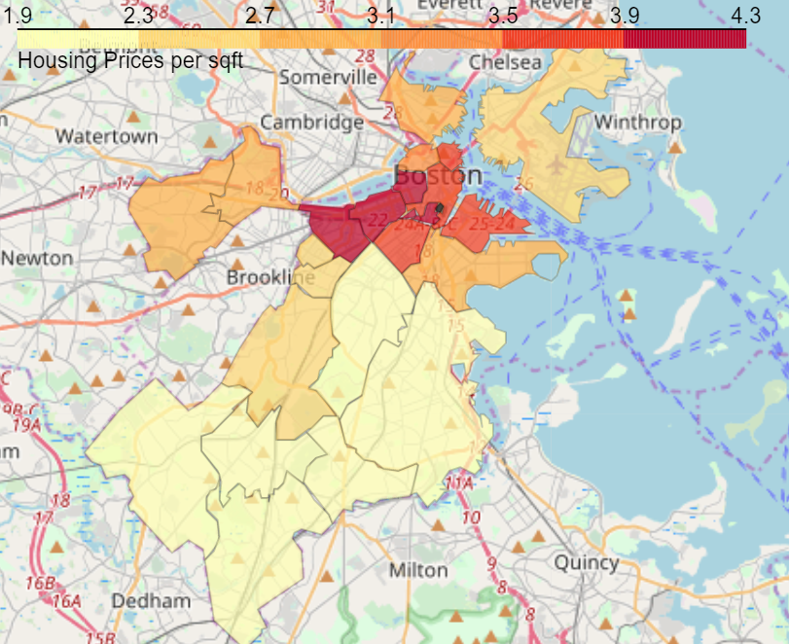
Choropleth map of crimes

Slide 9
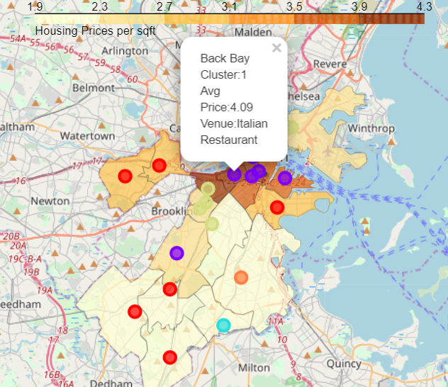
Clusters of Venues

Slide 10
Results
Crime rate is higher in the south of Boston which is an insight for Police Department to take more measures.
Rent prices are higher in South Boston but earning opportunities are greater so there is a tradeoff.
Clusters of different venues provide great information to new restaurant owners of ideal location

Slide 11
Thank You!!!!

